Slide 1
Unit 2: For Live Session Assignment
By Justin Ehly

Slide 2
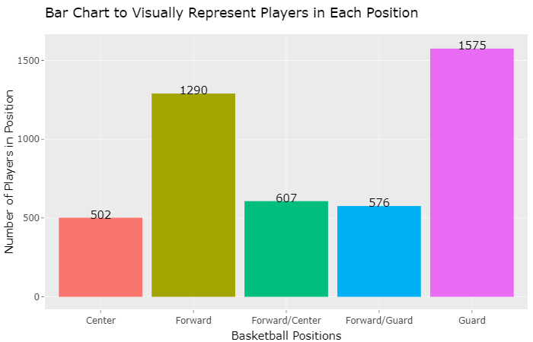
Assignment: Use the PlayerBBall.csv dataset to visually represent (summarize) the number of players in each position. Visual Bar Plot

Slide 3
Assignment: Use the PlayerBBall.csv dataset to visually represent (summarize) the number of players in each position. Visual Bar Plot
#Install Packages and activate libraries
install.packages("ggplot2",repos = "http://cran.us.r-project.org")
install.packages("ggplot2")
install.packages("tidyverse")
install.packages("ggthemes")
install.packages("plotly")
install.packages("dplyr")
library(ggplot2, tidyverse, ggthemes)
library(plotly)
library(dplyr)
library(tibble)
#get working directory
getwd() #"C:/Users/justi.DATA-POWER/Google Drive/_SMU/6306/Live Session Assignments"
#Download PlayerBBall.csv dataset - additional commands can be found here: https://swcarpentry.github.io/r-novice-inflammation/11-supp-read-write-csv/
rm(list=ls()) #deletes all data and values that may be hanging around in the R environment
PlayersBBall <- read.csv(file = 'C:/Users/justi.DATA-POWER/Google Drive/_SMU/6306/MSDS_6306_Doing-Data-Science/Unit 2/PlayersBBall.csv',
stringsAsFactors = FALSE,
strip.white = TRUE,
sep = ",") #stringsasfactors - makes sure we record the data as strings and not factors, strip.white removes any blank spaces in front of data in cells, sep = "," tells R that we are importing a comma separated file

Slide 4
Assignment: Use the PlayerBBall.csv dataset to visually represent (summarize) the number of players in each position. Visual Bar Plot
PlayersBBall[2143,"position"] = "G" #fixing a missing value for George Karl
PlayersBBall[2143,"height"] = "6-2" #fixing a missing value for George Karl
PlayersBBall[2143,"weight"] = 185 #fixing a missing value for George Karl
PlayersBBall[2143,] #checking for edits
#Create new column to record actual player positions using case_when (https://therbootcamp.github.io/Erfurt_2018June/_sessions/D1S2_Wrangling/Wrangling_practical.html)
position_name = data.frame(position_name = case_when(
#is.na(PlayersBBall$position) ~ "missing",
PlayersBBall$position == "F-C" ~ "Forward/Center",
PlayersBBall$position == "C-F" ~ "Forward/Center",
PlayersBBall$position == "C" ~ "Center",
PlayersBBall$position == "G" ~ "Guard",
PlayersBBall$position == "F" ~ "Forward",
PlayersBBall$position == "F-G" ~ "Forward/Guard",
PlayersBBall$position == "G-F" ~ "Forward/Guard",
TRUE ~ "others")) #Replaces blank new column $position_name with a name based on the abbreviated position in $position
#Combine the data frames to add the position_name column to PlayersBBall
PlayersBBall <- cbind(PlayersBBall,position_name)
#Convert data frames to a tibble (http://www.sthda.com/english/wiki/reordering-data-frame-columns-in-r)
BBPlayers <- as_data_frame(PlayersBBall)
View(BBPlayers) #opens up entire tibble in separate tab to verify data
#rearrange columns to ensure data accuracy
colnames(BBPlayers) #list column names to ensure accuracy
col_order <- c("name", "year_start", "year_end", "position", "position_name", "height", "weight", "birth_date", "college")
BBPlayers <- BBPlayers[, col_order] #reorders columns by column names
view(BBPlayers) #opens up entire tibble in separate tab to verify data

Slide 5
Assignment: Use the PlayerBBall.csv dataset to visually represent (summarize) the number of players in each position. Visual Bar Plot
#Visually represent the players in each position
#help with geom_text: https://stackoverflow.com/questions/26553526/how-to-add-frequency-count-labels-to-the-bars-in-a-bar-graph-using-ggplot2
p = BBPlayers %>%
ggplot(aes(x = position_name, fill = position_name)) +
geom_bar() +
ggtitle("Bar Chart to Visually Represent Players in Each Position") +
xlab("Basketball Positions") + ylab("Number of Players in Position") +
geom_text(stat = 'count', aes(label=..count..),nudge_y = 12) +
theme(legend.position = "none")
ggplotly(p, tooltip = position_name) #calls ploty interactive bar chart

Slide 6
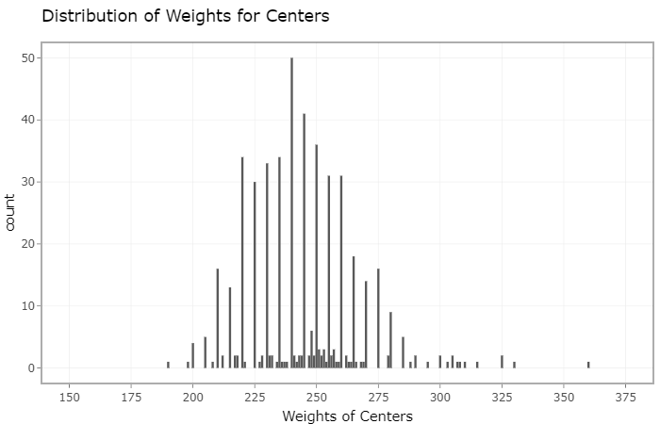
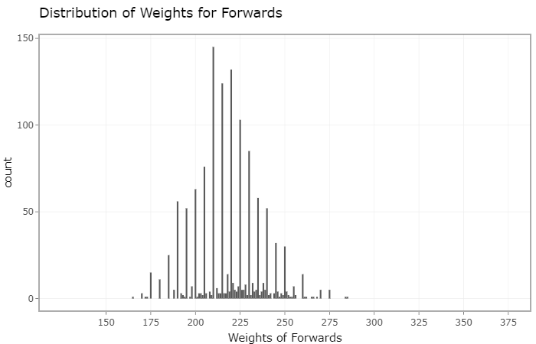
Assignment: Use the dataset to visually investigate the distribution of the weight of centers (C) is greater than the distribution of the weight of forwards (F). Visual Bar Plot

Slide 7
Assignment: Use the dataset to visually investigate the distribution of the weight of centers (C) is greater than the distribution of the weight of forwards (F). R Code
#Install Packages and activate libraries
library(ggplot2, tidyverse, ggthemes)
library(plotly)
library(dplyr)
library(tibble)
rm(list=ls()) #deletes all data and values that may be hanging around in the R environment
PlayersBBall <- read.csv(file = 'C:/Users/justi.DATA-POWER/Google Drive/_SMU/6306/MSDS_6306_Doing-Data-Science/Unit 2/PlayersBBall.csv',
na.strings = c("", "NA", "#N/A"),
stringsAsFactors = FALSE,
strip.white = TRUE,
sep = ",") #stringsasfactors - makes sure we record the data as strings and not factors, strip.white removes any blank spaces in front of data in cells, sep = "," tells R that we are importing a comma separated file
#Create new column to record actual player positions using case_when (https://therbootcamp.github.io/Erfurt_2018June/_sessions/D1S2_Wrangling/Wrangling_practical.html)
position_name = data.frame(position_name = case_when(
#is.na(PlayersBBall$position) ~ "NA",
PlayersBBall$position == "F-C" ~ "Forward/Center",
PlayersBBall$position == "C-F" ~ "Forward/Center",
PlayersBBall$position == "C" ~ "Center",
PlayersBBall$position == "G" ~ "Guard",
PlayersBBall$position == "F" ~ "Forward",
PlayersBBall$position == "F-G" ~ "Forward/Guard",
PlayersBBall$position == "G-F" ~ "Forward/Guard")) #Replaces blank new column $position_name with a name based on the abbreviated position in $position

Slide 8
Assignment: Use the dataset to visually investigate the distribution of the weight of centers (C) is greater than the distribution of the weight of forwards (F). R Code
#Combine the data frames to add the position_name column to PlayersBBall
PlayersBBall <- cbind(PlayersBBall,position_name)
#Convert data frames to a tibble (http://www.sthda.com/english/wiki/reordering-data-frame-columns-in-r)
BBPlayers <- as_data_frame(PlayersBBall)
#rearrange columns to ensure data accuracy
colnames(BBPlayers) #list column names to ensure accuracy
col_order <- c("name", "year_start", "year_end", "position", "position_name", "height", "weight", "birth_date", "college")
BBPlayers <- BBPlayers[, col_order] #reorders columns by column names
#Visually represent the players in each position
#help with geom_text: https://stackoverflow.com/questions/26553526/how-to-add-frequency-count-labels-to-the-bars-in-a-bar-graph-using-ggplot2
centers = BBPlayers[BBPlayers$position_name == "Center",] %>% #assigns variable center to the ggplot
ggplot(aes(x = weight)) +
geom_bar(stat = "count") + #calls bar chart
ggtitle("Distribution of Weights for Centers") + #bar chart title
scale_x_continuous(name = "Weights of Centers", limits = c(150,375), breaks = seq(150, 375, 25)) + #controls the name of the xaxis, the upper and lower limits and sets a tick every 25lbs
theme_bw() #removes background color
ggplotly(centers) #passes the centers ggplot data to ggplotly for interactive graph
forwards = BBPlayers[BBPlayers$position_name == "Forward",] %>% #assigns variable forwards to the ggplot
ggplot(aes(x = weight)) +
geom_bar(stat = "count") + #calls bar chart
ggtitle("Distribution of Weights for Forwards") + #sets bar chart title
scale_x_continuous(name = "Weights of Forwards", limits = c(125,375), breaks = seq(150, 375, 25)) + #controls the xaxis title, the upper and lower limits and sets a tick every 25lbs
theme_bw() #removes background color
ggplotly(forwards) #passes the forwards ggplot data to ggplotly for interactive graph

Slide 9
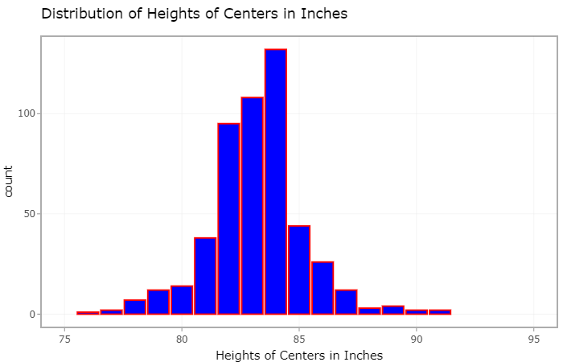
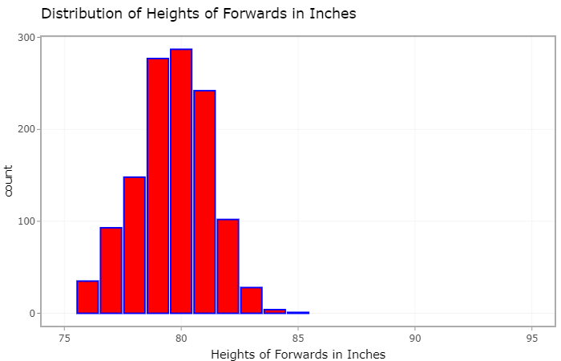
Assignment: Use the dataset to visually investigate if the distribution of the height of centers (C) is greater than the distribution of the height of forwards (F).

Slide 10
Assignment: Use the dataset to visually investigate if the distribution of the height of centers (C) is greater than the distribution of the height of forwards (F). R Code
#Install Packages and activate libraries
library(ggplot2, tidyverse, ggthemes)
library(plotly)
library(dplyr)
library(tibble)
rm(list=ls()) #deletes all data and values that may be hanging around in the R environment
PlayersBBall <- read.csv(file = 'C:/Users/justi.DATA-POWER/Google Drive/_SMU/6306/MSDS_6306_Doing-Data-Science/Unit 2/PlayersBBall.csv',
na.strings = c("", "NA", "#N/A"),
stringsAsFactors = FALSE,
strip.white = TRUE,
sep = ",") #stringsasfactors - makes sure we record the data as strings and not factors, strip.white removes any blank spaces in front of data in cells, sep = "," tells R that we are importing a comma separated file
#Create new column to record actual player positions using case_when (https://therbootcamp.github.io/Erfurt_2018June/_sessions/D1S2_Wrangling/Wrangling_practical.html)
position_name = data.frame(position_name = case_when(
#is.na(PlayersBBall$position) ~ "NA",
PlayersBBall$position == "F-C" ~ "Forward/Center",
PlayersBBall$position == "C-F" ~ "Forward/Center",
PlayersBBall$position == "C" ~ "Center",
PlayersBBall$position == "G" ~ "Guard",
PlayersBBall$position == "F" ~ "Forward",
PlayersBBall$position == "F-G" ~ "Forward/Guard",
PlayersBBall$position == "G-F" ~ "Forward/Guard")) #Replaces blank new column $position_name with a name based on the abbreviated position in $position

Slide 11
Assignment: Use the dataset to visually investigate if the distribution of the height of centers (C) is greater than the distribution of the height of forwards (F). R Code
#Combine the data frames to add the position_name column to PlayersBBall
PlayersBBall <- cbind(PlayersBBall,position_name)
#Convert data frames to a tibble (http://www.sthda.com/english/wiki/reordering-data-frame-columns-in-r)
BBPlayers <- as_data_frame(PlayersBBall)
#rearrange columns to ensure data accuracy
colnames(BBPlayers) #list column names to ensure accuracy
col_order <- c("name", "year_start", "year_end", "position", "position_name", "height", "weight", "birth_date", "college")
BBPlayers <- BBPlayers[, col_order] #reorders columns by column names
#separate the height feet and inches
BBPlayers <- BBPlayers %>% separate(height, c("feet", "inches"), sep = "-", convert = TRUE)
#create a new column called height_inches that = feet * 12 + inches to record all heights in inches
BBPlayers$height_inches <- (BBPlayers$feet * 12) + BBPlayers$inches

Slide 12
Assignment: Use the dataset to visually investigate if the distribution of the height of centers (C) is greater than the distribution of the height of forwards (F). R Code
#######################-----Asignment--------------------------#################
#Use the dataset to visually investigate if the distribution of the height of centers (C) is greater than the distribution of the height of forwards (F).
centers_height = BBPlayers[BBPlayers$position_name == "Center",] %>% #assigns variable center to the ggplot
ggplot(aes(x = height_inches)) +
geom_bar(fill = "blue", color = "red", stat = "count") + #calls bar chart
ggtitle("Distribution of Heights of Centers in Inches") + #bar chart title
scale_x_continuous(name = "Heights of Centers in Inches", limits = c(75,95), breaks = seq(75, 95, 5)) + #controls the name of the xaxis, the upper and lower limits and sets a tick every 25lbs
theme_bw() #removes background color
ggplotly(centers_height) #passes the centers ggplot data to ggplotly for interactive graph
forwards_heights = BBPlayers[BBPlayers$position_name == "Forward",] %>% #assigns variable forwards to the ggplot
ggplot(aes(x = height_inches)) +
geom_bar(fill = "red", color = "blue", stat = "count") + #calls bar chart
ggtitle("Distribution of Heights of Forwards in Inches") + #sets bar chart title
scale_x_continuous(name = "Heights of Forwards in Inches", limits = c(75,95), breaks = seq(75, 95, 5)) + #controls the xaxis title, the upper and lower limits and sets a tick every 25lbs
theme_bw() #removes background color
ggplotly(forwards_heights) #passes the forwards ggplot data to ggplotly for interactive graph

Slide 13
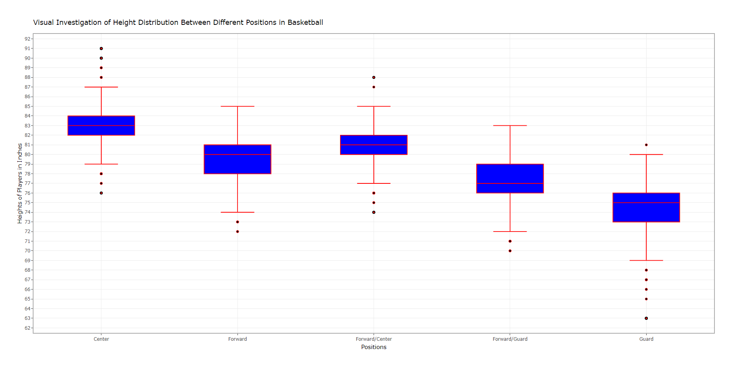
Assignment: Use the dataset to visually investigate if the distribution of height is different between any of the positions. Visual Bar Plot

Slide 14
Assignment: Use the dataset to visually investigate if the distribution of height is different between any of the positions. Visual Bar Plot R Code
#Install Packages and activate libraries
library(ggplot2, tidyverse, ggthemes)
library(plotly)
library(dplyr)
library(tibble)
rm(list=ls()) #deletes all data and values that may be hanging around in the R environment
PlayersBBall <- read.csv(file = 'C:/Users/justi.DATA-POWER/Google Drive/_SMU/6306/MSDS_6306_Doing-Data-Science/Unit 2/PlayersBBall.csv',
na.strings = c("", "NA", "#N/A"),
stringsAsFactors = FALSE,
strip.white = TRUE,
sep = ",") #stringsasfactors - makes sure we record the data as strings and not factors, strip.white removes any blank spaces in front of data in cells, sep = "," tells R that we are importing a comma separated file
#Create new column to record actual player positions using case_when (https://therbootcamp.github.io/Erfurt_2018June/_sessions/D1S2_Wrangling/Wrangling_practical.html)
position_name = data.frame(position_name = case_when(
#is.na(PlayersBBall$position) ~ "NA",
PlayersBBall$position == "F-C" ~ "Forward/Center",
PlayersBBall$position == "C-F" ~ "Forward/Center",
PlayersBBall$position == "C" ~ "Center",
PlayersBBall$position == "G" ~ "Guard",
PlayersBBall$position == "F" ~ "Forward",
PlayersBBall$position == "F-G" ~ "Forward/Guard",
PlayersBBall$position == "G-F" ~ "Forward/Guard")) #Replaces blank new column $position_name with a name based on the abbreviated position in $position

Slide 15
Assignment: Use the dataset to visually investigate if the distribution of height is different between any of the positions. Visual Bar Plot R Code
#Combine the data frames to add the position_name column to PlayersBBall
PlayersBBall <- cbind(PlayersBBall,position_name)
#Convert data frames to a tibble (http://www.sthda.com/english/wiki/reordering-data-frame-columns-in-r)
BBPlayers <- as_data_frame(PlayersBBall)
#rearrange columns to ensure data accuracy
colnames(BBPlayers) #list column names to ensure accuracy
col_order <- c("name", "year_start", "year_end", "position", "position_name", "height", "weight", "birth_date", "college")
BBPlayers <- BBPlayers[, col_order] #reorders columns by column names
#separate the height feet and inches
BBPlayers <- BBPlayers %>% separate(height, c("feet", "inches"), sep = "-", convert = TRUE)
#create a new column called height_inches that = feet * 12 + inches to record all heights in inches
BBPlayers$height_inches <- (BBPlayers$feet * 12) + BBPlayers$inches

Slide 16
Assignment: Use the dataset to visually investigate if the distribution of height is different between any of the positions. Visual Bar Plot R Code
#######################-------------Assignment----------------------#################
###Distribution of Height is different between any of the positions
all_heights <- BBPlayers %>%
ggplot(BBPlayers = subset(BBPlayers,!is.na(feet)), aes(x = position_name, y = height_inches)) +
geom_boxplot(fill = "blue", color = "red") +
ggtitle("Visual Investigation of Height Distribution Between Different Positions in Basketball") +
xlab("Positions") +
scale_y_continuous(name = "Heights of Players in Inches", breaks = seq(60, 95, 1)) +
theme_bw() #removes background color, sets to white
ggplotly(all_heights)

Slide 17
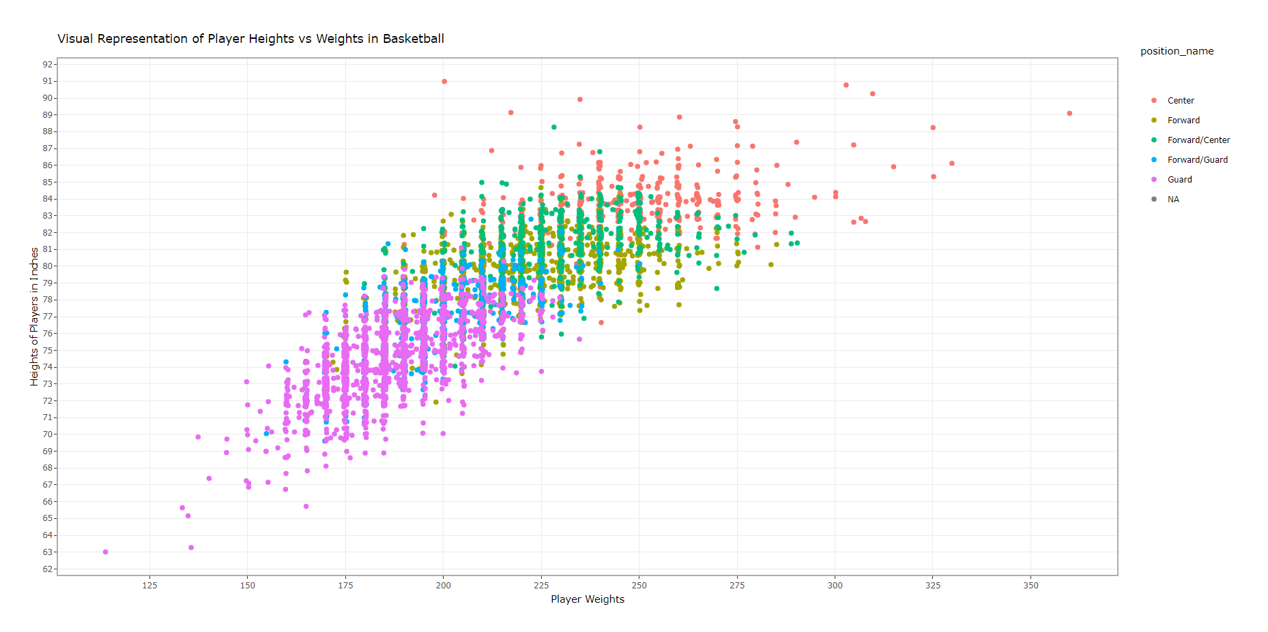
Assignment: Use the dataset to investigate how the player’s height is related to the player’s weight. How does height change as the weight changes?
Comment:
The weight appears to increase as the height increases with basketball players.

Slide 18
Assignment: Use the dataset to investigate how the player’s height is related to the player’s weight. How does height change as the weight changes? R Code
#Install Packages and activate libraries
library(ggplot2, tidyverse, ggthemes)
library(plotly)
library(dplyr)
library(tibble)
rm(list=ls()) #deletes all data and values that may be hanging around in the R environment
PlayersBBall <- read.csv(file = 'C:/Users/justi.DATA-POWER/Google Drive/_SMU/6306/MSDS_6306_Doing-Data-Science/Unit 2/PlayersBBall.csv',
na.strings = c("", "NA", "#N/A"),
stringsAsFactors = FALSE,
strip.white = TRUE,
sep = ",") #stringsasfactors - makes sure we record the data as strings and not factors, strip.white removes any blank spaces in front of data in cells, sep = "," tells R that we are importing a comma separated file
#Create new column to record actual player positions using case_when (https://therbootcamp.github.io/Erfurt_2018June/_sessions/D1S2_Wrangling/Wrangling_practical.html)
position_name = data.frame(position_name = case_when(
#is.na(PlayersBBall$position) ~ "NA",
PlayersBBall$position == "F-C" ~ "Forward/Center",
PlayersBBall$position == "C-F" ~ "Forward/Center",
PlayersBBall$position == "C" ~ "Center",
PlayersBBall$position == "G" ~ "Guard",
PlayersBBall$position == "F" ~ "Forward",
PlayersBBall$position == "F-G" ~ "Forward/Guard",
PlayersBBall$position == "G-F" ~ "Forward/Guard")) #Replaces blank new column $position_name with a name based on the abbreviated position in $position

Slide 19
Assignment: Use the dataset to investigate how the player’s height is related to the player’s weight. How does height change as the weight changes? R Code
#Combine the data frames to add the position_name column to PlayersBBall
PlayersBBall <- cbind(PlayersBBall,position_name)
#Convert data frames to a tibble (http://www.sthda.com/english/wiki/reordering-data-frame-columns-in-r)
BBPlayers <- as_data_frame(PlayersBBall)
#rearrange columns to ensure data accuracy
colnames(BBPlayers) #list column names to ensure accuracy
col_order <- c("name", "year_start", "year_end", "position", "position_name", "height", "weight", "birth_date", "college")
BBPlayers <- BBPlayers[, col_order] #reorders columns by column names
#separate the height feet and inches
BBPlayers <- BBPlayers %>% separate(height, c("feet", "inches"), sep = "-", convert = TRUE)
#create a new column called height_inches that = feet * 12 + inches to record all heights in inches
BBPlayers$height_inches <- (BBPlayers$feet * 12) + BBPlayers$inches

Slide 20
Assignment: Use the dataset to investigate how the player’s height is related to the player’s weight. How does height change as the weight changes? R Code
#######################-------------Assignment----------------------#################
# Use the dataset to investigate how the player’s height is related to the player’s weight. How does height change as the weight changes?
Players <- BBPlayers %>%
ggplot(BBPlayers = subset(BBPlayers,!is.na(feet)), aes(x = weight, y = height_inches)) +
geom_point(aes(color = position_name), position = "jitter") +
ggtitle("Visual Representation of Player Heights vs Weights in Basketball") +
scale_x_continuous(name = "Player Weights", breaks = seq(100,375, 25)) +
scale_y_continuous(name = "Heights of Players in Inches", breaks = seq(60, 95, 1)) +
theme_bw() #removes background color, sets to white
ggplotly(Players)

Slide 21
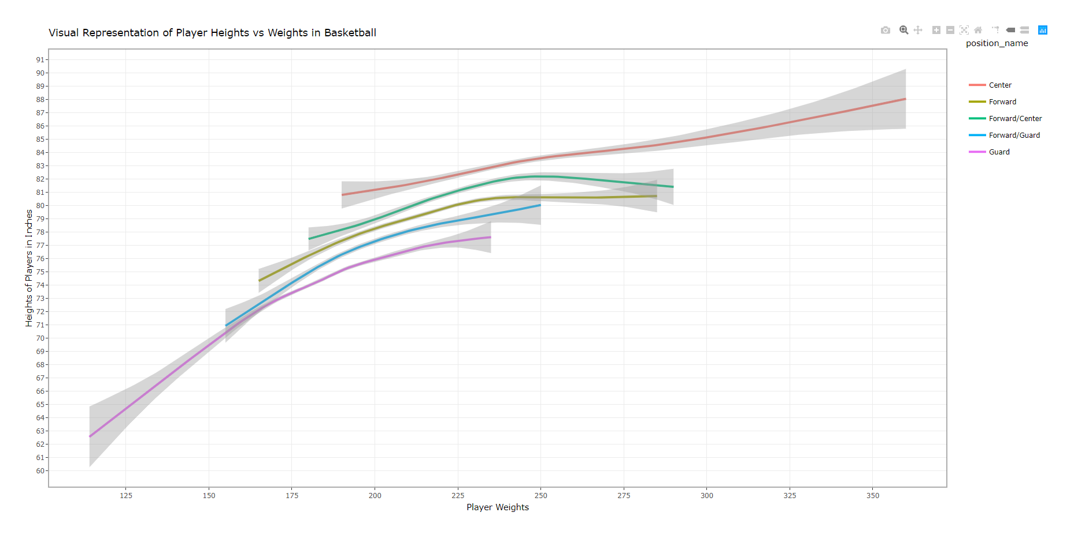
Assignment: Is their any difference in the relationship between height and weight between positions? Are height and weight related differently for different positions.
Comment:
This is an apparent difference in weights and heights by position, while there is quite a bit of overlap, we can make some general observations that such that the evidence suggests that Centers and Guards have the broadest range of heights and weights, with Centers being the tallest and heaviest and Guards being the shortest and lightest. The data also suggests that Forwards, Forward/Centers and Forward/Guards are all similar in terms of heights and weights, with Forward/Center’s being the tallest and heaviest of the sub-group, followed by Forwards and then by Forward/ Guards.

Slide 22
Assignment: Is their any difference in the relationship between height and weight between positions? Are height and weight related differently for different positions R Code
#Install Packages and activate libraries
library(ggplot2, tidyverse, ggthemes)
library(plotly)
library(dplyr)
library(tibble)
rm(list=ls()) #deletes all data and values that may be hanging around in the R environment
PlayersBBall <- read.csv(file = 'C:/Users/justi.DATA-POWER/Google Drive/_SMU/6306/MSDS_6306_Doing-Data-Science/Unit 2/PlayersBBall.csv',
na.strings = c("", "NA", "#N/A"),
stringsAsFactors = FALSE,
strip.white = TRUE,
sep = ",") #stringsasfactors - makes sure we record the data as strings and not factors, strip.white removes any blank spaces in front of data in cells, sep = "," tells R that we are importing a comma separated file
#Create new column to record actual player positions using case_when (https://therbootcamp.github.io/Erfurt_2018June/_sessions/D1S2_Wrangling/Wrangling_practical.html)
position_name = data.frame(position_name = case_when(
#is.na(PlayersBBall$position) ~ "NA",
PlayersBBall$position == "F-C" ~ "Forward/Center",
PlayersBBall$position == "C-F" ~ "Forward/Center",
PlayersBBall$position == "C" ~ "Center",
PlayersBBall$position == "G" ~ "Guard",
PlayersBBall$position == "F" ~ "Forward",
PlayersBBall$position == "F-G" ~ "Forward/Guard",
PlayersBBall$position == "G-F" ~ "Forward/Guard")) #Replaces blank new column $position_name with a name based on the abbreviated position in $position

Slide 23
Assignment: Is their any difference in the relationship between height and weight between positions? Are height and weight related differently for different positions R Code
#Combine the data frames to add the position_name column to PlayersBBall
PlayersBBall <- cbind(PlayersBBall,position_name)
#Convert data frames to a tibble (http://www.sthda.com/english/wiki/reordering-data-frame-columns-in-r)
BBPlayers <- as_data_frame(PlayersBBall)
#rearrange columns to ensure data accuracy
colnames(BBPlayers) #list column names to ensure accuracy
col_order <- c("name", "year_start", "year_end", "position", "position_name", "height", "weight", "birth_date", "college")
BBPlayers <- BBPlayers[, col_order] #reorders columns by column names
#separate the height feet and inches
BBPlayers <- BBPlayers %>% separate(height, c("feet", "inches"), sep = "-", convert = TRUE)
#create a new column called height_inches that = feet * 12 + inches to record all heights in inches
BBPlayers$height_inches <- (BBPlayers$feet * 12) + BBPlayers$inches

Slide 24
Assignment: Is their any difference in the relationship between height and weight between positions? Are height and weight related differently for different positions R Code
#######################-------------Assignment----------------------#################
# Is their any difference in the relationship between height and weight between positions? Are height and weight related differently for different positions.
Players2 <- BBPlayers %>%
ggplot(BBPlayers = subset(BBPlayers,!is.na(feet)), aes(x = weight, y = height_inches, color = position_name)) +
geom_smooth() +
ggtitle("Visual Representation of Player Heights vs Weights in Basketball by Position") +
scale_x_continuous(name = "Player Weights", breaks = seq(100,375, 25)) +
scale_y_continuous(name = "Heights of Players in Inches", breaks = seq(60, 95, 1)) +
theme_bw() #removes background color, sets to white
ggplotly(Players2)

Slide 25
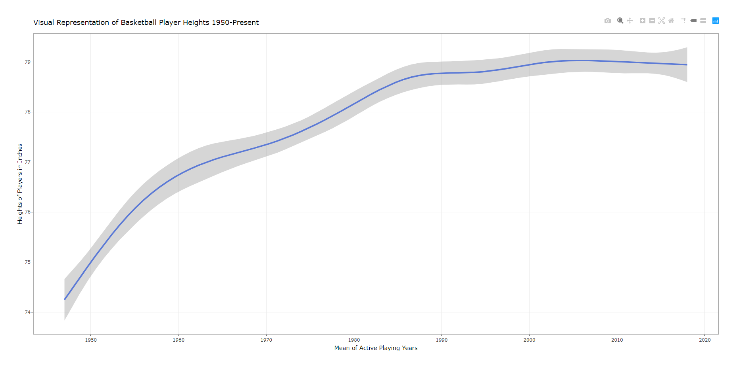
Assignment: A historian would like to investigate the claim that the heights of players have increased over the years. Analyze this claim graphically / visually.

Slide 26
Assignment: A historian would like to investigate the claim that the heights of players have increased over the years. Analyze this claim graphically / visually R Code
#Install Packages and activate libraries
library(ggplot2, tidyverse, ggthemes)
library(plotly)
library(dplyr)
library(tibble)
rm(list=ls()) #deletes all data and values that may be hanging around in the R environment
PlayersBBall <- read.csv(file = 'C:/Users/justi.DATA-POWER/Google Drive/_SMU/6306/MSDS_6306_Doing-Data-Science/Unit 2/PlayersBBall.csv',
na.strings = c("", "NA", "#N/A"),
stringsAsFactors = FALSE,
strip.white = TRUE,
sep = ",") #stringsasfactors - makes sure we record the data as strings and not factors, strip.white removes any blank spaces in front of data in cells, sep = "," tells R that we are importing a comma separated file
#Create new column to record actual player positions using case_when (https://therbootcamp.github.io/Erfurt_2018June/_sessions/D1S2_Wrangling/Wrangling_practical.html)
position_name = data.frame(position_name = case_when(
#is.na(PlayersBBall$position) ~ "NA",
PlayersBBall$position == "F-C" ~ "Forward/Center",
PlayersBBall$position == "C-F" ~ "Forward/Center",
PlayersBBall$position == "C" ~ "Center",
PlayersBBall$position == "G" ~ "Guard",
PlayersBBall$position == "F" ~ "Forward",
PlayersBBall$position == "F-G" ~ "Forward/Guard",
PlayersBBall$position == "G-F" ~ "Forward/Guard")) #Replaces blank new column $position_name with a name based on the abbreviated position in $position

Slide 27
Assignment: A historian would like to investigate the claim that the heights of players have increased over the years. Analyze this claim graphically / visually R Code
#Combine the data frames to add the position_name column to PlayersBBall
PlayersBBall <- cbind(PlayersBBall,position_name)
#Convert data frames to a tibble (http://www.sthda.com/english/wiki/reordering-data-frame-columns-in-r)
BBPlayers <- as_data_frame(PlayersBBall)
#rearrange columns to ensure data accuracy
colnames(BBPlayers) #list column names to ensure accuracy
col_order <- c("name", "year_start", "year_end", "position", "position_name", "height", "weight", "birth_date", "college")
BBPlayers <- BBPlayers[, col_order] #reorders columns by column names
#separate the height feet and inches
BBPlayers <- BBPlayers %>% separate(height, c("feet", "inches"), sep = "-", convert = TRUE)
#create a new column called height_inches that = feet * 12 + inches to record all heights in inches
BBPlayers$height_inches <- (BBPlayers$feet * 12) + BBPlayers$inches

Slide 28
Assignment: A historian would like to investigate the claim that the heights of players have increased over the years. Analyze this claim graphically / visually R Code
#######################-------------Assignment----------------------#################
# A historian would like to investigate the claim that the heights of players have increased over the years. Analyze this claim graphically / visually.
#create mean playing year for analysis
BBPlayers$MeanYear = (BBPlayers$year_start + BBPlayers$year_end) / 2
head(BBPlayers$MeanYear)
PlayersHeights <- BBPlayers %>%
ggplot(BBPlayers = subset(BBPlayers,!is.na(feet)), aes(x = MeanYear, y = height_inches)) +
geom_smooth() +
#geom_point(position = "jitter") +
ggtitle("Visual Representation of Basketball Player Heights 1950-Present") +
scale_x_continuous(name = "Mean of Active Playing Years", breaks = seq(1950, 2020, 10)) +
scale_y_continuous(name = "Heights of Players in Inches", breaks = seq(60, 95, 1)) +
theme_bw() #removes background color, sets to white
ggplotly(PlayersHeights)

Slide 29
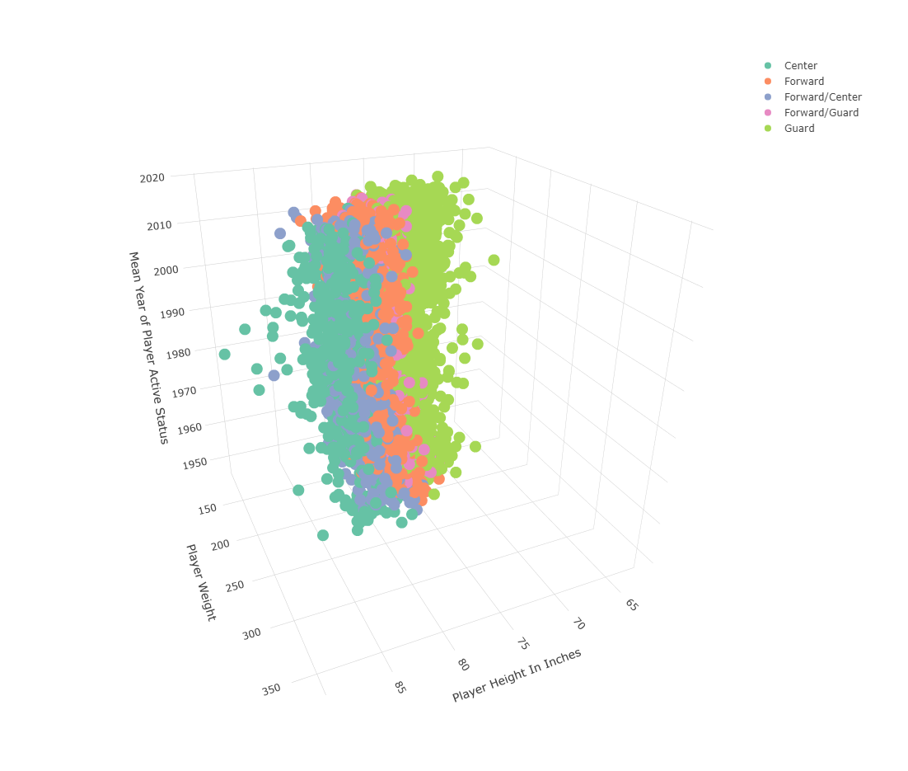
Assignment: Create a 3D plot of height vs. weight vs. year and color code the points by position

Slide 30
Assignment: Assignment: Create a 3D plot of height vs. weight vs. year and color code the points by position R Code
#Install Packages and activate libraries
library(ggplot2, tidyverse, ggthemes)
library(plotly)
library(dplyr)
library(tibble)
rm(list=ls()) #deletes all data and values that may be hanging around in the R environment
PlayersBBall <- read.csv(file = 'C:/Users/justi.DATA-POWER/Google Drive/_SMU/6306/MSDS_6306_Doing-Data-Science/Unit 2/PlayersBBall.csv',
na.strings = c("", "NA", "#N/A"),
stringsAsFactors = FALSE,
strip.white = TRUE,
sep = ",") #stringsasfactors - makes sure we record the data as strings and not factors, strip.white removes any blank spaces in front of data in cells, sep = "," tells R that we are importing a comma separated file
#Create new column to record actual player positions using case_when (https://therbootcamp.github.io/Erfurt_2018June/_sessions/D1S2_Wrangling/Wrangling_practical.html)
position_name = data.frame(position_name = case_when(
#is.na(PlayersBBall$position) ~ "NA",
PlayersBBall$position == "F-C" ~ "Forward/Center",
PlayersBBall$position == "C-F" ~ "Forward/Center",
PlayersBBall$position == "C" ~ "Center",
PlayersBBall$position == "G" ~ "Guard",
PlayersBBall$position == "F" ~ "Forward",
PlayersBBall$position == "F-G" ~ "Forward/Guard",
PlayersBBall$position == "G-F" ~ "Forward/Guard")) #Replaces blank new column $position_name with a name based on the abbreviated position in $position

Slide 31
Assignment: Assignment: Create a 3D plot of height vs. weight vs. year and color code the points by position R Code
#Combine the data frames to add the position_name column to PlayersBBall
PlayersBBall <- cbind(PlayersBBall,position_name)
#Convert data frames to a tibble (http://www.sthda.com/english/wiki/reordering-data-frame-columns-in-r)
BBPlayers <- as_data_frame(PlayersBBall)
#rearrange columns to ensure data accuracy
colnames(BBPlayers) #list column names to ensure accuracy
col_order <- c("name", "year_start", "year_end", "position", "position_name", "height", "weight", "birth_date", "college")
BBPlayers <- BBPlayers[, col_order] #reorders columns by column names
#separate the height feet and inches
BBPlayers <- BBPlayers %>% separate(height, c("feet", "inches"), sep = "-", convert = TRUE)
#create a new column called height_inches that = feet * 12 + inches to record all heights in inches
BBPlayers$height_inches <- (BBPlayers$feet * 12) + BBPlayers$inches

Slide 32
Assignment: Assignment: Create a 3D plot of height vs. weight vs. year and color code the points by position R Code
#######################-------------Assignment----------------------#################
#Create a 3D plot of height vs. weight vs. year and color code the points by position
Players3D #calls for variable "Players3D" to run
#Ploylt using Basketball Player data
Players3D <- plot_ly(BBPlayers, x = ~height_inches, y = ~weight, z = ~MeanYear, color = ~position_name) %>%
add_markers() %>%
layout( scene = list(
xaxis = list(title = 'Player Height In Inches'),
yaxis = list(title = 'Player Weight'),
zaxis = list(title = 'Mean Year of Player Active Status')
))
#runs the 3D plot by calling up #Players3D"
Players3D

Slide 33
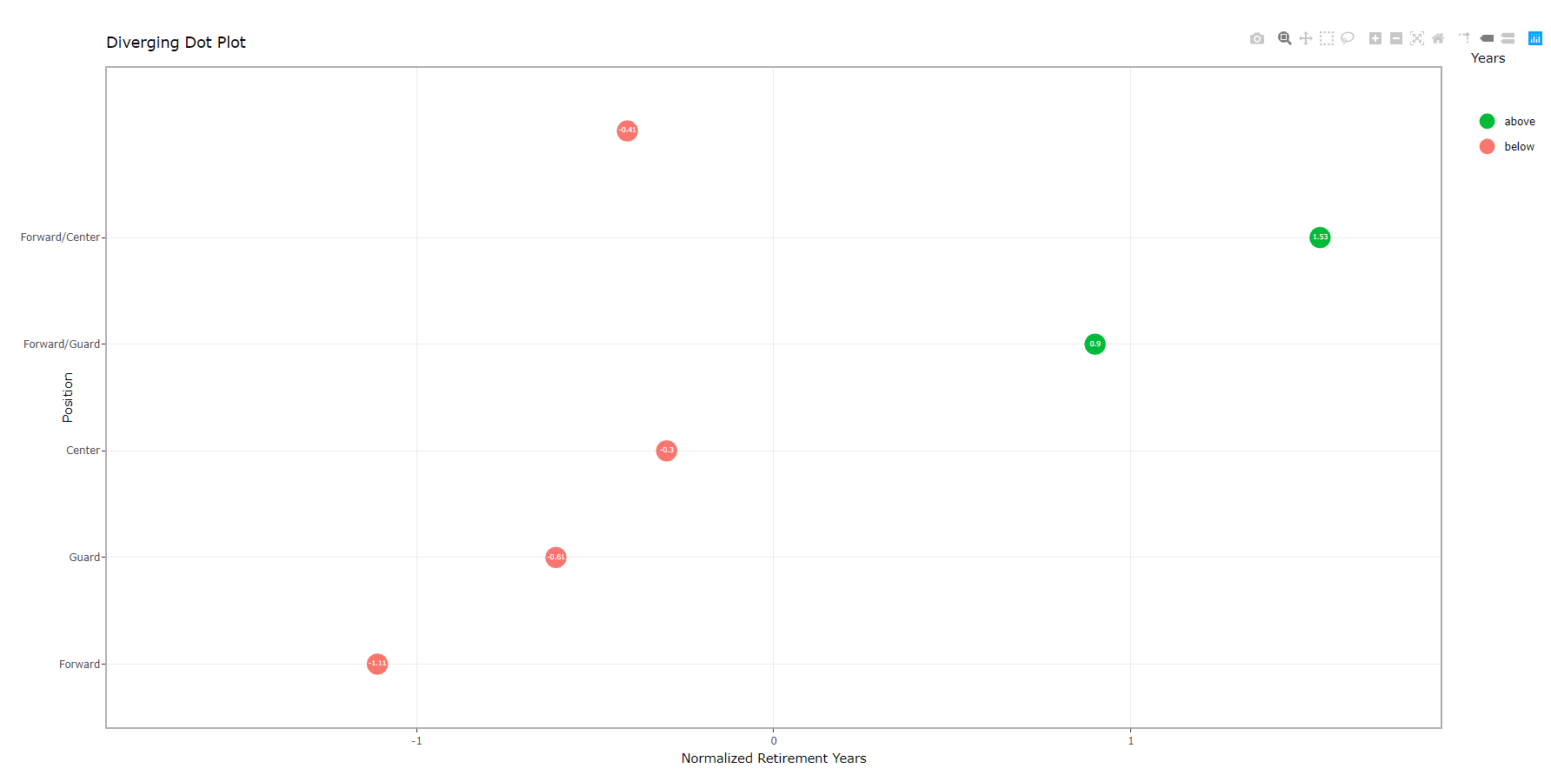
Go to this website and use one of the 50 best plots to visualize some aspect of the data and provide at least one insight. You will present your work in breakout! http://r-statistics.co/Top50-Ggplot2-Visualizations-MasterList-R-Code.html
Insight:
The data suggests that Forward/ Centers and Forward/ Guards play longer in the NBA than Centers, Guards or Forwards based on the above and below normalized years of play in the league

Slide 34
Assignment: Go to this website and use one of the 50 best plots to visualize some aspect of the data and provide at least one insight. You will present your work in breakout! http://r-statistics.co/Top50-Ggplot2-Visualizations-MasterList-R-Code.html R Code
#Install Packages and activate libraries
library(ggplot2, tidyverse, ggthemes)
library(plotly)
library(dplyr)
library(tibble)
rm(list=ls()) #deletes all data and values that may be hanging around in the R environment
PlayersBBall <- read.csv(file = 'C:/Users/justi.DATA-POWER/Google Drive/_SMU/6306/MSDS_6306_Doing-Data-Science/Unit 2/PlayersBBall.csv',
na.strings = c("", "NA", "#N/A"),
stringsAsFactors = FALSE,
strip.white = TRUE,
sep = ",") #stringsasfactors - makes sure we record the data as strings and not factors, strip.white removes any blank spaces in front of data in cells, sep = "," tells R that we are importing a comma separated file
#Create new column to record actual player positions using case_when (https://therbootcamp.github.io/Erfurt_2018June/_sessions/D1S2_Wrangling/Wrangling_practical.html)
position_name = data.frame(position_name = case_when(
#is.na(PlayersBBall$position) ~ "NA",
PlayersBBall$position == "F-C" ~ "Forward/Center",
PlayersBBall$position == "C-F" ~ "Forward/Center",
PlayersBBall$position == "C" ~ "Center",
PlayersBBall$position == "G" ~ "Guard",
PlayersBBall$position == "F" ~ "Forward",
PlayersBBall$position == "F-G" ~ "Forward/Guard",
PlayersBBall$position == "G-F" ~ "Forward/Guard")) #Replaces blank new column $position_name with a name based on the abbreviated position in $position

Slide 35
Assignment: Go to this website and use one of the 50 best plots to visualize some aspect of the data and provide at least one insight. You will present your work in breakout! http://r-statistics.co/Top50-Ggplot2-Visualizations-MasterList-R-Code.html R Code
#Combine the data frames to add the position_name column to PlayersBBall
PlayersBBall <- cbind(PlayersBBall,position_name)
#Convert data frames to a tibble (http://www.sthda.com/english/wiki/reordering-data-frame-columns-in-r)
BBPlayers <- as_data_frame(PlayersBBall)
#rearrange columns to ensure data accuracy
colnames(BBPlayers) #list column names to ensure accuracy
col_order <- c("name", "year_start", "year_end", "position", "position_name", "height", "weight", "birth_date", "college")
BBPlayers <- BBPlayers[, col_order] #reorders columns by column names
#separate the height feet and inches
BBPlayers <- BBPlayers %>% separate(height, c("feet", "inches"), sep = "-", convert = TRUE)
#create a new column called height_inches that = feet * 12 + inches to record all heights in inches
BBPlayers$height_inches <- (BBPlayers$feet * 12) + BBPlayers$inches

Slide 36
Assignment: Go to this website and use one of the 50 best plots to visualize some aspect of the data and provide at least one insight. You will present your work in breakout! http://r-statistics.co/Top50-Ggplot2-Visualizations-MasterList-R-Code.html R Code
#Diverging Dot Plot
#Plot Average Years in NBA by Retirement Year
#library(ggplot2)
#library(lubridate)
theme_set(theme_bw())
NBAYears <- PlayerAverage %>%
ggplot(PlayerAverage = subset(PlayerAverage,is.na.data.frame(PlayerAverage)), aes(x = Position, y = AvgYears_z, label = AvgYears_z)) +
geom_point(stat = 'identity', aes(col = AvgYears_Type), size = 6) +
scale_color_manual(name = "Years",
labels = c("Above Average", "Below Average"),
values = c("above" = "#00ba38", "below" = "#f8766d")) +
geom_text(color = "white", size = 2) +
labs(title = "Diverging Dot Plot",
subtitle = "Normalized years of retirement from 'NBA Data'") +
xlab("Position") +
ylab("Normalized Retirement Years") +
ylim(-1.7,1.7) +
coord_flip()
ggplotly(NBAYears)

Slide 37
Assignment: Go to this website and use one of the 50 best plots to visualize some aspect of the data and provide at least one insight. You will present your work in breakout! http://r-statistics.co/Top50-Ggplot2-Visualizations-MasterList-R-Code.html R Code
#Diverging Dot Plot
#Plot Average Years in NBA by Retirement Year
#library(ggplot2)
#library(lubridate)
theme_set(theme_bw())
NBAYears <- PlayerAverage %>%
ggplot(PlayerAverage = subset(PlayerAverage,is.na.data.frame(PlayerAverage)), aes(x = Position, y = AvgYears_z, label = AvgYears_z)) +
geom_point(stat = 'identity', aes(col = AvgYears_Type), size = 6) +
scale_color_manual(name = "Years",
labels = c("Above Average", "Below Average"),
values = c("above" = "#00ba38", "below" = "#f8766d")) +
geom_text(color = "white", size = 2) +
labs(title = "Diverging Dot Plot",
subtitle = "Normalized years of retirement from 'NBA Data'") +
xlab("Position") +
ylab("Normalized Retirement Years") +
ylim(-1.7,1.7) +
coord_flip()
ggplotly(NBAYears)

Slide 38
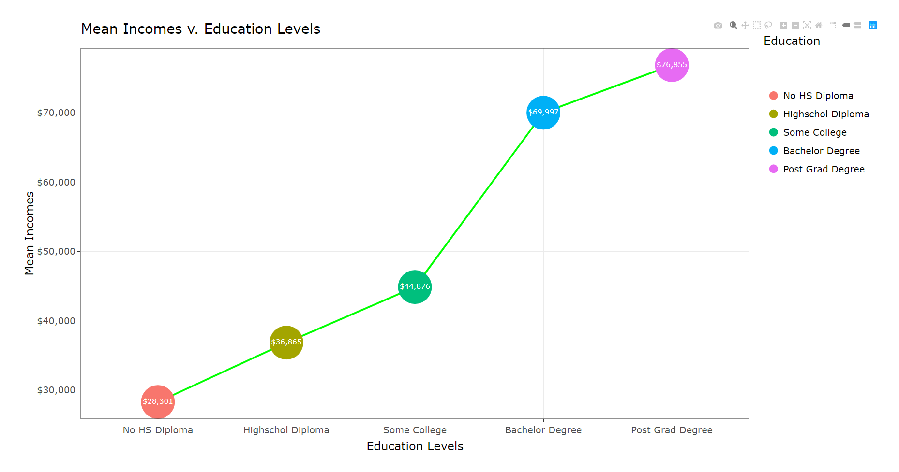
Assignment: Visually test the claim that the distribution of incomes increase (mean or median) as the education level rises. Graph

Slide 39
Assignment: Visually test the claim that the distribution of incomes increase (mean or median) as the education level rises. R Code for Graph
#Install Packages and activate libraries
#install.packages("ggplot2",repos = "http://cran.us.r-project.org")
#install.packages("ggplot2")
#install.packages("tidyverse")
#install.packages("ggthemes")
#install.packages("plotly")
#install.packages("dplyr")
#install.packages("moonBook")
#library(ggplot2, tidyverse, ggthemes)
#library(plotly)
#library(dplyr)
#library(tibble)
#library(moonBook)
#library(scales)
#get working directory
getwd() #"C:/Users/justi.DATA-POWER/Google Drive/_SMU/6306/Live Session Assignments"
#clear all data and values from R Environment for a clean slate
rm(list=ls())
# Individual-observation data set
#Download EducationIncome.csv dataset from class github
EdIncome <- read.csv(file = 'C:/Users/justi.DATA-POWER/Google Drive/_SMU/6306/MSDS_6306_Doing-Data-Science/Unit 2/Education_Income.csv',
stringsAsFactors = FALSE,
strip.white = TRUE,
sep = ",") #stringsasfactors - makes sure we record the data as strings and not factors, strip.white removes any blank spaces in front of data in cells, sep = "," tells R that we are importing a comma separated file

Slide 40
Assignment: Visually test the claim that the distribution of incomes increase (mean or median) as the education level rises. R Code for Graph
# Data Prep #
#create a new data frames
# (1) Means Grouped by Education Level
# (2) Medians Grouped by Education Level
# credit: https://community.rstudio.com/t/finding-the-mean-of-a-column-for-specific-rows/45171/3
EduMean <- EdIncome %>% group_by(Educ) %>% summarize(IncMean = mean(Income2005))
EduMedian <- EdIncome %>% group_by(Educ) %>% summarize(IncMedian = median(Income2005))
#create a working variable for EdIncome$Educ (shortens amount of typing)
var1 <- EduMean$Educ
# Provide a rank for each Education level
Edu_Rank <- data.frame(Edu_Rank = case_when(
var1 == ">16" ~ 5,
var1 == "16" ~ 4,
var1 == "13-15" ~ 3,
var1 == "12" ~ 2,
var1 == "<12" ~ 1))
#Add Ranking to Each EduMean
EduMean <- cbind(EduMean, Edu_Rank)
var2 <- EduMedian$Educ
# Provide a rank for each Education level
Edu_Rank2 <- data.frame(Edu_Rank2 = case_when(
var2 == ">16" ~ 5,
var2 == "16" ~ 4,
var2 == "13-15" ~ 3,
var2 == "12" ~ 2,
var2 == "<12" ~ 1))

Slide 41
Assignment: Visually test the claim that the distribution of incomes increase (mean or median) as the education level rises. R Code for Graph
#Add Ranking to Each EduMedian
EduMedian <- cbind(EduMedian, Edu_Rank2)
#Rename columns
colnames(EduMean) <- c("Education", "IncMean", "Edu_Rank")
colnames(EduMedian) <- c("Education1", "IncMedian", "Edu_Rank1")
#Combine data frames into EduMoney
EduMoney <- cbind(EduMean,EduMedian)
# Rename each Education level
EduMoney$Education = case_when(
EduMoney$Education == ">16" ~ "Post Grad Degree",
EduMoney$Education == "16" ~ "Bachelor Degree",
EduMoney$Education == "13-15" ~ "Some College",
EduMoney$Education == "12" ~ "Highschol Diploma",
EduMoney$Education == "<12" ~ "No HS Diploma")
#remove unneeded columns
EduMoney <- subset(EduMoney, select = -c(Education1, Edu_Rank1))
# Sort EduMoney by Edu_Rank
EduMoney <- EduMoney[order(EduMoney$Edu_Rank),] # sort
EduMoney$Education <- factor(EduMoney$Education, levels=unique(EduMoney$Education)) #convert to factor to retain sorted order in plot
# Build Visuals dervied from Source: https://stackoverflow.com/questions/32588215/add-multiple-geom-line-to-ggplot

Slide 42
Assignment: Visually test the claim that the distribution of incomes increase (mean or median) as the education level rises. R Code for Graph
# Build Visuals dervied from Source: https://stackoverflow.com/questions/32588215/add-multiple-geom-line-to-ggplot
IncEdu <- EduMoney %>%
ggplot(aes(x = Education, y = IncMean, group = 1, color = Education)) +
geom_line(size = 1, color = "green") +
geom_point(size = 18) + #creates large data point
geom_text(aes(label = dollar(round(IncMean),1)), color = "white", size = 4) + # converts IncMean to Dollars
ggtitle(" Mean Incomes v. Education Levels") +
scale_y_continuous(labels=scales::dollar_format()) +
ylab("Mean Incomes") +
xlab("Education Levels") +
theme_bw(base_size = 18)
ggplotly(IncEdu)

